Slide 1
Capstone Project-1
Hotel Booking Analysis Done by: Shadab Husain & Istekhar Ansari

Slide 2
Project Summary
The data related to hotel booking is dynamic for any hospitality business as it gives insights into booking activities of customers as well as channels.
This projects covers the analysis of the provided dataset relating to hotel bookings for city hotel and resort hotel.
Project activities has been Categorised as under:
>Defining the problem statement
>Collection and preparation of data by data cleaning ,treating outliers etc.
>Perform exploratory data analysis(EDA)
>Provide observations as well as recommendations based on the EDA.

Slide 3
Content
>Problem statement
>Data Collection
>Python libraries used
>Data cleaning and manipulation
>EDA and data visualization
>Challenges
>Suggestions to achieve business objective
>Conclusion

Slide 4
Problem statement
For this project we will be analyzing Hotel Booking data. This data set encloses booking information for a city hotel and a resort hotel, and it contains information such as when the booking was made, length of stay, the number of adults, children or babies and the number of vacant parking spaces.
The main objective behind this project is to explore and analyze data to determine important factors that manage the booking and give insights to hotel management, which can implement various campaigns to increase the business and performance.
Hotel industry is a very unstable industry and the booking depends on below factors and many more.

Slide 5
Work flow separation
So we have divided our work flow into following 3 Steps:
Data collection and understanding
Data cleaning and manipulation
Exploratory data analysis(EDA)

Slide 6
Data collection
After collecting data it’s very important to understand it. We have hotel booking in which we have 119390 rows and 32 columns. Let’s understand these 32 columns.
Description of data:
hotel: Resort Hotel or City hotel.
is canceled: Value indicating if the booking was cancelled (1) or not (0).
lead time: Number of days that elapsed between the entering date of the booking and the arrival date.
Arrival date year: Year of arrival date.
Arrival date month: Month of arrival date.
Arrival date day of month: Day of arrival date.
Stays in weekend nights: Number of weekend nights.
Stays in week nights: Number of week nights.
adults : Number of adults.
children : Number of babies.
meal : Type of meal booked.
country : Country of origin.

Slide 7
Data collection
Market_segment : Market segment designation (TA/TO).
Distribution_channel : Booking distribution channel (TA/TO).
Is_repeated_guest : is a repeat guest (1) or not (0).
Previous_cancellations : Number of previous bookings which were cancelled by the customer prior the current booking.
Previous_booking_not_cancelled : Number of previous bookings not cancelled by the customer prior to the current booking.
Reserved_room_type : Code of room type resereved.
Assigned_room_type : Code for the type of room assigned to the booking.
Booking_changes : Number of changes made to the booking from the moment the booking was entered on the PMS (Hotel property management systems) untill the moment of check-in or cancellation.
Deposite_type : No deposit, Non refund, Refundable.
Agent: ID of the travel agency that made the booking.
Company: ID of the company/ entity that made the booking.
Days_in_waiting_list : Number of days the booking.
Customer_type : type of customer. Contract, Group, Transient, Transient party.
Adr : Average daily rate as defined by dividing the sum of all lodging transactions by the total number of staying nights.
Required_car_parking_spaces : Number of car parking spaces required by the customer.
total_of_special_request : Number of special requests made by the customer (e.g double bed or high floor).
Reservation_status: Reservation last status.

Slide 8
Python libraries used
>Numpy
>Pandas
>Matplotlib
>Seaborn

Slide 9
Data cleaning and manipulation
Given data has 31994 duplicate values. So the duplicate values are dropped by using duplicates().
Data has 4 columns that have missing values and those columns are company(82137), agent(12193), country(452) and children(4). So the missing values of columns company, agent and children are replaced by 0 and the missing values of column country are replaced by others by using fillna().

Slide 10
Data cleaning and manipulation (continue)...
There are some rows in data that have the total number of adults, children or babies equal to zero this means there is no booking made, So I remove such rows.
Added some new columns for better analysis.

Slide 11
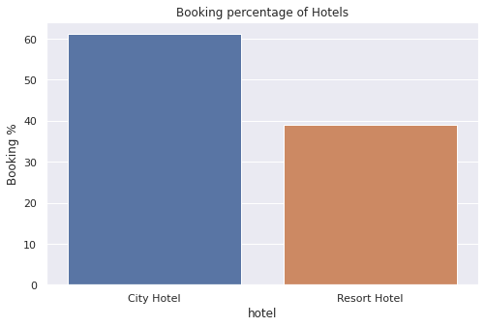
Exploratory data analysis(EDA)
Booking percentage of hotels :
Around 60% people prefer City hotel &
40% people prefer Resort hotel.
Adr of Resort hotel is slightly lower than
that of City hotel. Hence, City hotel seems
to be making slightly more revenue.

Slide 12
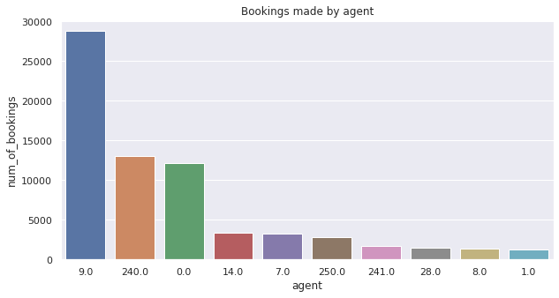
Which Agent makes most no. of bookings :
Bar chart is used to
Visualize which agent
Covers the most no. of
Bookings. It is observed
that Agent no. 9.0
makes Most of the
bookings which is more
than 25000 while agent
no. 1.0 has the least
no. Of bookings.

Slide 13
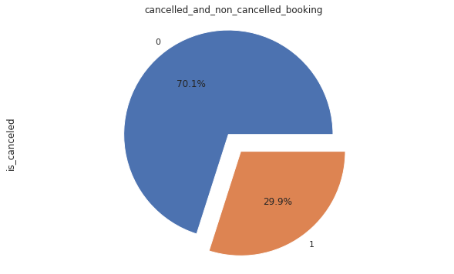
Hotel cancel rate :
The pie chart has been used
to visualize the distribution
Of booking cancellation.
According to this pie chart
70.1% is non cancel booking
While 29.9% booking cancel
in the Hotel.

Slide 14
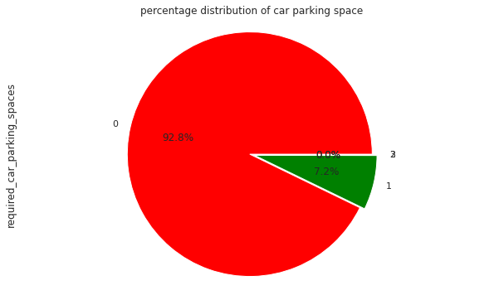
Percentage distribution of car parking space :
The parking space was not
needed by 91.6% of the visitors.
while 8.3% of visitors only needed
one parking space.

Slide 15
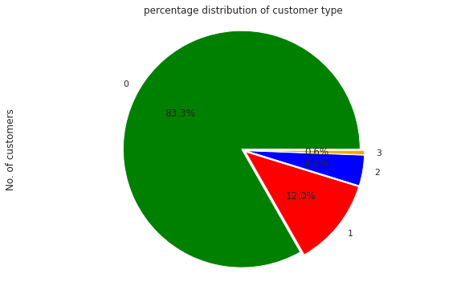
What is the percentage distribution of "Customer Type"? :
Transient customer type
is more which is 82.4 %.
Percentage of Booking
associated by the group
is vey low

Slide 16
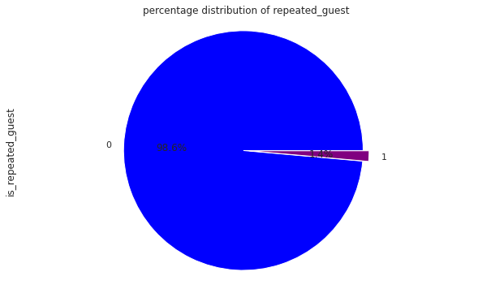
Count of repeated guest :
Pie chart has been used to
Visualize the percentage
Distribution of repeated
Guest.
Repeated guests are very
few which only 1.4 %.
In order to retain the guests,
management should take
feedbacks from guests and
try to improve the services.

Slide 17
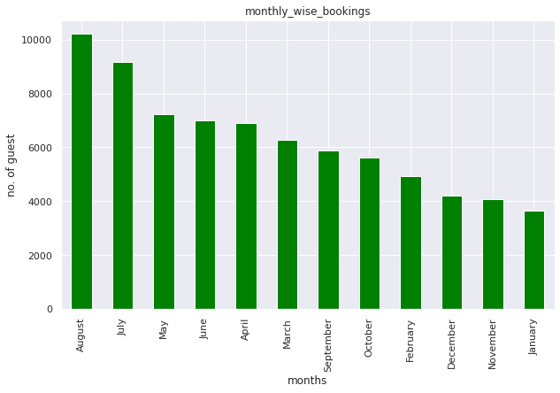
In which month most of the bookings happened?
In this bar chart July and
August months had
the most Bookings.
Summer vocation can
be the reason for the
bookings.

Slide 18
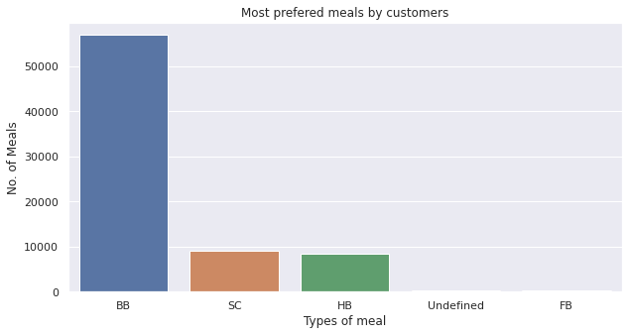
Most preferred meal by customers :
1.BB - (Bed and Breakfast)
2.HB - (Half Bread)
3.FB - (Full Board)
4.SC - (Self Catering)
The chart shows most of the customers prefer BB type Meal.

Slide 19
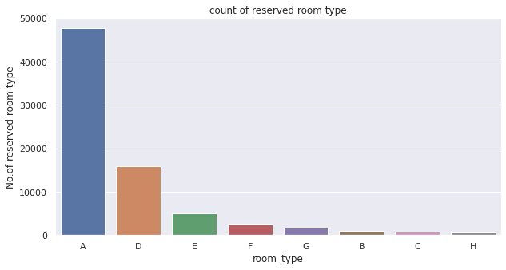
Most preferred room type by the customers :
Almost everytime
Most of the people
preferred Room
type is 'A’.

Slide 20
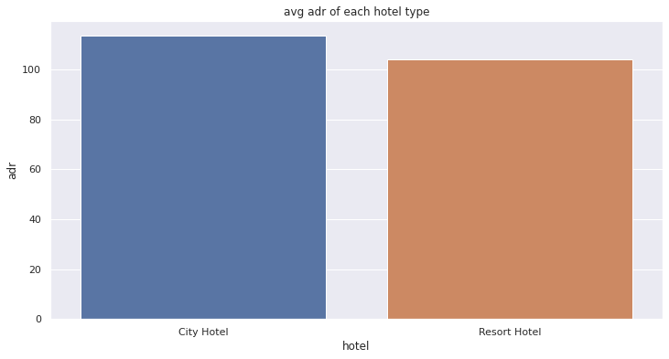
Which Hotel type has the highest ADR? :
In this bar graph ,
Comparison of both
Hotels with respect
to ADR i.e average
Daily rate.
City Hotel has the
highest ADR. This
means City Hotels
are generating more
revenue than the
resort hotels. More
the ADR, more is the
revenue.

Slide 21
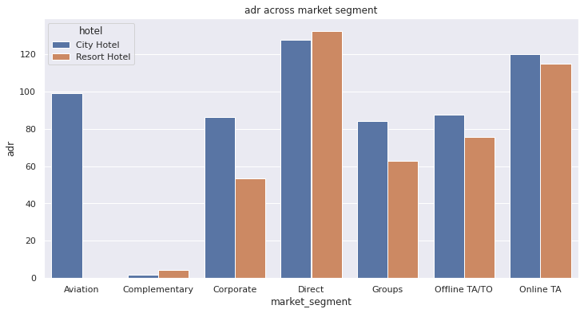
ADR across different market segment :
Seaborn library is used for
making the plot of
Market segment.
'Direct' and 'Online TA' are
contributing the most
in both types of hotels.
Aviation segment
should focus on
increasing the bookings
of ‘Resort Hotel’.

Slide 22
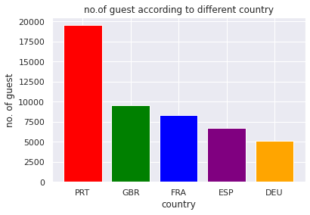
Number of guest according to different country :
For this plot we have used seaborn
Library to depict the no. of guest
According to different country
Most of the guest is coming
From Portugal and Great Britain
Country.
After Portugal and GBR
(Great Britain), France, Spain
are the countries from
where most of the guests
Came.

Slide 23
Challenges
Reading the dataset and understanding the meaning of columns.
For answering some questions we should know the business model of hotel that how they work.
Lots of column to work on takes lot of time to identify which column to select to start with.
Lots of null values in data set.
Dataset contains a lot of duplications.

Slide 24
Suggestions to achieve business objective
Our main business objective was to rise bookings ,decrease cancellation and rise customer retention. Based on our examination ,some references we came up with are as follows :
>Additional public marketing can help raise the number of visitors from certain nations .Even after they leave, more effort can be taken to keep them by keeping in touch with them by personalized emails, phone ,calls etc.
>Agents and market sectors that bring in more clients should also be recognized
With awards and incentives.
>Cancellation had a strong connection with new clients. If new clients are disposed to cancel ,further efforts should be taken to retain them by providing discounts and offers.

Slide 25
Suggestions to achieve business objective(continue)…
>Data of visitors stay can be used to send them personalized offers to maximize their chances of bookings.
>Launching loyalty customer programs to reward loyal customers.
>The period of each visitor stay can be utilized to create a clever pricing model that should prolong one’s stay.
>Extra efforts should be made to foster positive relationships with clients which can be done by sending them engaging emails such as “Thank You” and “Happy Holiday” etc.
Good customer evaluations can have a significant impact on a hotel’s brand value and it is important to consider customer feedback and reviews in order to improve hotel amenities and the guest experience.

Slide 26
Conclusion
>During Summer Season the hotels have get some no. of bookings than any other seasons. So, if You want to enjoy privacy You can book in remaining seasons.
>Majority of the Bookings happen through direct and online as it is very easy and effective way.
>mostly 60% people prefer City hotel & 40% people prefer Resort hotel.
>Adr of Resort hotel is slightly lower than that of City hotel. Hence, City hotel seems to be making slightly more revenue.
>Most of the booking is agent no.9 he is more than 25000 booked.
>According to the analysis 70.1% is non cancel booking While 29.9% booking cancel in the Hotel.

Slide 27
Conclusion(continue)…
>The parking space was not needed by 91.6% of the visitors while 8.3% of visitors only needed one parking space.
>Transient customer type is more which is 82.4 %. Percentage of Booking associated by the group is vey low.
>Repeated guests are very few which only 1.4 %. In order to retain the guests, management should take feedbacks from guests and try to improve the services.
>In this bar chart July and August months had the most Bookings. Summer vocation can be the reason for the bookings.
>Most of the guest is coming From Portugal and Great Britain Country. After Portugal and GBR(Great Britain), France,Spain are the countries from where most of the guests Came.

Slide 28
THANK YOU

